Slide 1


ACS College of Engineering
Precise Trajectory Propagation and Events Prediction for Highly Eccentric Orbits
BAS686 –MAJOR PROJECT
First Review Meeting
SUPERVISOR:
Mr. Vijay M
CANDIDATE:
Girish Gowda S
Gowtham N
Harshith S Purohith

Slide 2
DATA SHEET
NAME | Girish Gowda S, Gowtham N, Harshith S Purohith
REGISTRATION NUMBER | 1AH23AS019, 1AH23AS020, 1AH23AS021
REGISTERED FOR | BACHELOR OF ENGINEERING
SPECILIALIZATION | AEROSPACE ENGINEERING [AEROSPACE STRUCTURES]
CATEGORY | FULL TIME
DATE OF JOINING | 04/09/2023
FIRST REVIEW MEETING | 15/04/2026
ACS College of Engineering ■■■

Slide 3
REVIEW MEETING MEMBERS
Mr. VIJAY M
ASSISSTANT PROFESSOR
DEPARTMENT OF AEROSPACE ENGINEERING
ACS COLLEGE OF ENGINEERING
Dr. SURESH C
HEAD OF DEPARTMENT
DEPARTMENT OF AEROSPACE ENGINEERING
ACS COLLEGE OF ENGINEERING
3. Dr. DHANYA PRAKASH R BABU
ASSOCIATE PROFESSOR
DEPARTMENT OF AEROSPACE ENGINEERING
ACS COLLEGE OF ENGINEERING
PROJECT GUIDE
HEAD OF DEPARTMENT
PROJECT CO-ORDINATOR
ACS College of Engineering ■■■

Slide 4
AREA OF THE PROJECT: SPACE MECHANICS
NATURE OF THE PROJECT:
TRAJECTORY CALCULATION, SIMULATION
AND MISSION PLANNING
ACS College of Engineering ■■■

Slide 5
AGENDA
INTRODUCTION
LITERATURE SURVEY
SUMMARY OF THE LITERATURE SURVEY
PROBLEM STATEMENT OF THE PROJECT
OBJECTIVE OF THE PROJECT
METHODOLOGY
WORK DONE
WORK TO BE DONE
GANTT CHART
ACS College of Engineering ■■■

Slide 6
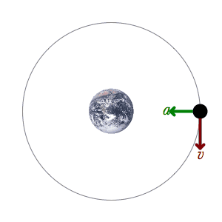
INTRODUCTION
An orbit is the curved trajectories of an object in space under the influence of gravitation. It is also known as an orbital revolution, because it is a rotation around an axis external to the moving body. Examples for orbits include the trajectory of a planet around a star, a natural satellite around a planet, or an artificial satellite around an object or position in space such as a planet, moon, asteroid or Lagrange point.. To a close approximation, planets and satellites follow elliptical orbits, with the center of mass being orbited at the focal point of the ellipse as described by Kepler’s laws of planetary motion.

Slide 7
Introduction
Kepler’s laws of planetary motion
Bodies following closed orbits repeat their paths with a certain time called the period. This motion is described by the empirical laws of Kepler, which can be mathematically derived from Newton's laws. These can be formulated as follows:
Kepler's First Law (Law of Ellipses):
It states that every planet moves in an elliptical orbit with the Sun located at one of the two foci.
Kepler’s Second Law (Law of Equal Areas):
It dictates that a line segment joining a planet and the Sun sweeps out equal areas during equal intervals of time.
Kepler's Third Law (Law of Periods):
It establishes a mathematical relationship where the square of a planet's orbital period is directly proportional to the cube of the semi-major axis of its orbit.
This can be expressed by the formula: T²∝a³ ,where T is the orbital period and a is the semi-major axis.

Slide 8
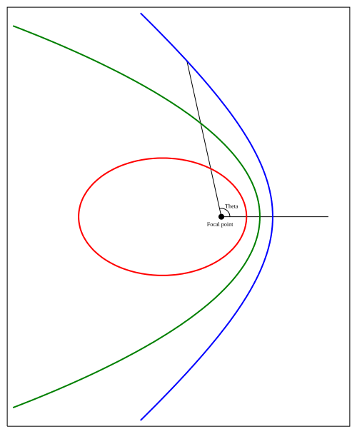
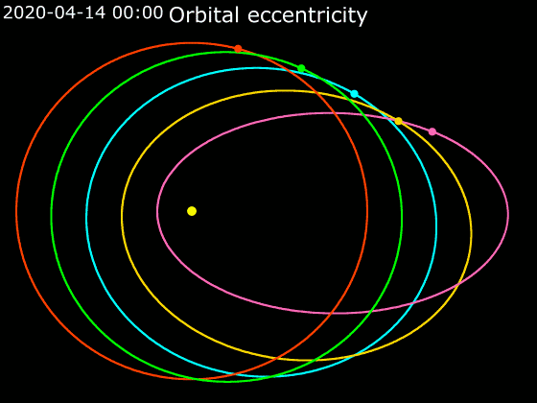
Introduction
Highly Eccentric Orbits feature a massive altitude variance, sweeping from very close to the Earth (perigee) to tens of thousands of kilometers away (apogee).
Critical Mission Applications:
Geostationary Transfer Orbits (GTO): The essential stepping-stone path for delivering telecommunications satellites to the equator.
High-Latitude Observation: Specialized paths like Molniya (12-hour) and Tundra (24-hour) orbits mimic geostationary coverage over polar regions, enabling continuous weather and intelligence monitoring.
Deep Space Staging: Utilizing Lunar Gravity Assists (LGAs) from highly inclined parking orbits to save massive amounts of fuel during complex orbital plane changes.

Slide 9
Introduction
Difficulties faced in HEOs:
A Highly Unstable Dynamic Environment
Extreme Force Variance: Spacecraft in HEOs traverse entirely different physical environments within a single orbit. They face intense atmospheric drag at low altitudes and complex lunisolar gravitational perturbations at high altitudes.
The Compounding Effect: These opposing forces couple together in non-linear ways. As drag shrinks the orbit over time, the timing of the gravitational pulls shifts dramatically.
The issue with Event Prediction in HEOs:
Due to this extreme sensitivity, standard trajectory models struggle to maintain accuracy over long durations.
Minor fluctuations in solar weather or initial launch conditions can cause critical predictions—such as satellite lifespan, re-entry dates, and exact constellation coverage windows—to miss the mark by years or hundreds of kilometers.

Slide 10
Introduction
J₂ perturbation
It is the perturbation caused due to the oblateness of the Earth.
Because the Earth spins, centrifugal force causes mass to collect around the equator. This makes the Earth an oblate spheroid rather than a perfect sphere. The Earth's equatorial radius is about 21 km larger than its polar radius. This additional mass around the equator exerts a non-uniform gravitational pull on satellites.
Its effects on the trajectory of the satellite:
It effects the orientation of the orbit in space.
Precession of the perigee: the line joining the apogee and perigee rotates within the orbital plane.
Recession of nodes: the entire plane of the orbit rotates around the Earth's polar axis.

Slide 11
LITERATURE REVIEW
Serial Number | Title of the paper/article | Name of the journal of proceedings | Author(s) | Year of Publication | Research Focus | Research findings
01 | Geostationary Orbit Transfer with Lunar Gravity Assist from Non-equatorial Launch Site | The Journal of the Astronautical Sciences | Su-Jin Choi, John Carrico, Mike Loucks, Hoonhee Lee, Sejin Kwon | 2021 | Demonstrates the feasibility of launching a satellite to Geostationary Equatorial orbit (GEO) from a mid-latitude launch site using a lunar gravity assist (LGA) transfer to avoid excessive ΔV costs from plane change manoeuvres. | High-fidelity orbit propagation models show that cislunar free-returns require less geostationary insertion ΔV than circumlunar returns, making ascending departures highly efficient for highly inclined parking orbits.
ACS College of Engineering ■■■

Slide 12
LITERATURE REVIEW
Serial Number | Title of the paper/article | Name of the journal of proceedings | Author(s) | Year of Publication | Research Focus | Research findings
02 | Analysis of Geostationary Transfer Orbit Long Term Evolution and Lifetime. | CNES (French Space Agency) / ISSFD | Alain Lamy, Clemence Le Fevre and Bruno Sarli | 2011 | Analyzes the long-term dynamics of objects in Geostationary Transfer Orbits (GTO) to understand lifetime dependencies for compliance with space debris regulations, highlighting the extreme sensitivity to initial conditions. | GTO trajectory predictions are highly complex because lunisolar gravitational perturbations at apogee couple with atmospheric drag at perigee, potentially causing dramatic jumps in perigee altitude when the semi-major axis reaches roughly 15,000 km.
ACS College of Engineering ■■■

Slide 13
LITERATURE REVIEW
Serial Number | Title of the paper/article | Name of the journal of proceedings | Author(s) | Year of Publication | Research Focus | Research findings
03 | Contemporaneous Monitoring of the Whole Dynamic Earth System from Space, Part I: System Simulation Study Using GEO and Molniya Orbits | Remote Sensing | Christopher Cullingworth and J P Muller | 2021 | Proposes and simulates a constellation of low-cost 3U CubeSats utilizing a combination of GEO and Molniya orbits to provide global, true color imaging with 5-minute update timescales. | Molniya orbits (63.4∘ critical inclination, 12-hour period) combined with FreeFlyer trajectory simulations enable continuous tracking of dynamic events across high-latitudes; highlights the severe radiation environment challenges these orbits face compared to LEO.
ACS College of Engineering ■■■

Slide 14
LITERATURE REVIEW
Serial Number | Title of the paper/article | Name of the journal of proceedings | Author(s) | Year of Publication | Research Focus | Research findings
04 | Understanding the imaging capability of Tundra orbits compared to other orbits | IEEE Transactions on Geoscience and Remote Sensing | Zhenglong Li, Timothy J Schmit, Jun Li, Mathew M Gunshor and Frederick W Nagle | 2020 | Investigates the imaging capabilities of 24-hour highly elliptical Tundra orbits equipped with Advanced Baseline Imagers (ABI), comparing them with LEO and GEO platforms for high-latitude and polar observation. | Tundra satellites offer long dwell times near apogee, making them ideal for providing continuous GEO-like imagery (< 4 km footprint size) over polar areas like Alaska; assesses Data Continuity (DC) and Effective Footprint Size (EFS) for regional event predictions.
ACS College of Engineering ■■■

Slide 15
LITERATURE REVIEW
Serial Number | Title of the paper/article | Name of the journal of proceedings | Author(s) | Year of Publication | Research Focus | Research findings
05 | On the Use of Satellites in Molniya Orbits for Meteorological Observation of Middle and High Latitudes | Journal of Atmospheric and Oceanic Technology | Stanley Q Kidder and Thomas H Vondar Haar | 1990 | A correspondence note outlining the advantages of placing meteorological instruments in Molniya orbits to dramatically improve the temporal frequency of observations for phenomena like polar lows. | Exploiting the critical inclination of 63.4∘ locks the apogee position, allowing the satellite's slow velocity near apogee to mimic a geostationary perspective at high latitudes; points out that three coordinated satellites can provide continuous hemispheric coverage.
ACS College of Engineering ■■■

Slide 16
LITERATURE REVIEW
Serial Number | Title of the paper/article | Name of the journal of proceedings | Author(s) | Year of Publication | Research Focus | Research findings
06 | Dynamical Modeling and Lifetime Analysis of Geostationary Transfer Orbits | Acta astronautica | Yue Wang, Pini Gurfil | 2016 | The study focuses on the long-term dynamical evolution and orbital lifetime of objects in Geostationary Transfer Orbits (GTO), specifically analyzing how perturbations like Earth's non-spherical gravity (J2), atmospheric drag, | The paper finds that GTO lifetimes are highly sensitive to initial orbital parameters and the argument of perigee, which determine whether lunisolar perturbations will naturally drive the perigee into the Earth's atmosphere. A key discovery is that by strategically selecting these initial launch conditions and debries affecting the satellite path
ACS College of Engineering ■■■

Slide 17
LITERATURE REVIEW
Serial Number | Title of the paper/article | Name of the journal of proceedings | Author(s) | Year of Publication | Research Focus | Research findings
07 | ANALYSIS OF GEOSTATIONARY TRANSFER ORBIT LONG TERM EVOLUTION AND LIFETIME | CNES(French space agency)/ISSFD | Alain LAMY , Clémence LE FEVRE , Bruno SARLI | 2011 | The primary objective of this study is to analyze the long-term orbital dynamics and decay of objects in Geostationary Transfer Orbits (GTO) to better understand the factors that most influence their orbital lifetime. To achieve this, the study investigates the complex interplay | The study concludes that GTO lifetime is extremely sensitive to initial conditions. A critical finding is the existence of a "resonant" phase when the semi-major axis reaches approximately 15,000 km; at this point, the perigee altitude can suddenly increase by hundreds of kilometers, effectively "stalling" the orbit and making precise lifetime predictions nearly impossible.
ACS College of Engineering ■■■

Slide 18
LITERATURE REVIEW
Serial Number | Title of the paper/article | Name of the journal of proceedings | Author(s) | Year of Publication | Research Focus | Research findings
08 | Dynamical properties of the Molniya satellite constellation: Long-term evolution of orbital eccentricity | Acta astronautica | Elisa Maria Alessi, Alberto Buzzoni, Jérôme Daquin, Albino Carbognani, Giacomo Tommei | 2021 | The research paper focuses on the development and evaluation of high-fidelity numerical and analytical models to predict the long-term orbital behavior of satellites in Molniya orbits. The primary research focus is on addressing the complex perturbations that affect these highly elliptical. | The research findings demonstrate that specialized semi-analytical propagators can achieve a high degree of computational efficiency without sacrificing the precision required for mission planning, compared to traditional Cowell’s numerical integration methods. It reveals that the stability of the argument of perigee is highly sensitive to J_2 perturbations.
ACS College of Engineering ■■■

Slide 19
LITERATURE REVIEW
Serial Number | Title of the paper/article | Name of the journal of proceedings | Author(s) | Year of Publication | Research Focus | Research findings
09 | Tundra constellation design and stationkeeping | Journal of spacecrafts and rockets | Michael J Bruno, Henry J Pernicka | 2005 | The research focuses on the high-fidelity numerical and analytical modeling of the trajectory propagation for satellites in a Tundra orbit, which is a figure-eight geosynchronous orbit with high inclination (typically near 63.4°) and high eccentricity. | The findings indicate that while the Tundra orbit provides significant advantages for polar coverage, its stability is highly sensitive to the resonance effects between the satellite’s orbital period and the Earth’s rotation, as well as the "critical inclination" which prevents the rotation of the perigee.
ACS College of Engineering ■■■

Slide 20
Literature Summary
Dynamic Modeling & Lifetime Prediction:
i) Long-term predictions for highly eccentric orbits (like GTOs) are extremely sensitive to initial conditions.
ii)Accurate propagation must account for the complex coupling of lunisolar gravitational perturbations at apogee and atmospheric drag at perigee.
Novel Trajectory Optimization:
High-fidelity propagation models enable the design of complex, fuel-saving maneuvers.
Example: Utilizing Lunar Gravity Assists (LGAs) to efficiently transfer satellites from highly inclined, non-equatorial parking orbits into geostationary orbits.
Continuous High-Latitude Observation
i)Tundra (24-hour) and Molniya (12-hour) orbits exploit a critical inclination of 63.4° to prevent the argument of perigee from drifting.
ii)This creates a prolonged "dwell time" near apogee, providing geostationary-like, continuous weather and earth observation over polar regions.
Constellation Event Simulation
i)Precise orbit simulators are required to predict real-time coverage events for HEO constellations.
ii)These tools calculate dynamic footprint sizes, predict ground sample distances, and manage observation handoffs between multiple satellites.

Slide 21
Literature Summary
Dynamical Modeling and Lifetime Analysis of Geostationary Transfer Orbits
i) Long-term predictions for highly eccentric orbits (like GTOs) are extremely sensitive to initial conditions.
ii)Accurate propagation must account for the complex coupling of lunisolar gravitational perturbations at apogee and atmospheric drag at perigee.
Analysis of Geostationary transfer orbit long term evolution and lifetime
High-fidelity propagation models enable the design of complex, fuel-saving maneuvers.
A critical finding is the existence of a "resonant" phase when the semi-major axis reaches approximately 15,000 km
Dynamical properties of the Molniya satellite constellation: Long-term evolution of orbital eccentricity
i) Development and evaluation of high-fidelity numerical and analytical models to predict the long-term orbital behavior of satellites in Molniya orbits. ii) By refining trajectory propagation algorithms, the study aims to improve the accuracy of position forecasting and life-cycle analysis for communication and early-warning satellites that require stable dwell times over high-latitude regions.
Tundra constellation design and station keeping
By analyzing these forces, the research seeks to improve the accuracy of long-term orbital position predictions and stability assessments for telecommunications and surveillance missions that require dwell time over high-latitude regions

Slide 22
Problem Statement
The utilization of Highly Eccentric Orbits (HEOs) is vital for next-generation space missions, ranging from Lunar Gravity Assist (LGA) transfers to continuous polar Earth observation via Molniya and Tundra constellations. However, precise trajectory propagation and event prediction in these regimes present a severe astro-dynamic challenge. Spacecraft in HEOs traverse highly disparate dynamic environments within a single orbital period; they are subjected to dense, variable atmospheric drag at perigee, and complex third-body (lunisolar) gravitational perturbations at apogee.
Current orbital models struggle to account for the non-linear coupling of these forces over long durations. Minor uncertainties in initial conditions or solar activity can compound rapidly, causing long-term event predictions—such as satellite lifetime and re-entry dates—to vary by decades. Therefore, to ensure the operational viability, precise spatial targeting, and regulatory compliance (e.g., space debris mitigation) of future HEO missions, a robust, high-fidelity trajectory propagation framework must be developed to accurately predict short-term observation events and long-term orbital evolution.
.

Slide 23
Objectives
Integrate Coupled Perturbation Models: Develop a dynamic modeling environment that accurately couples low-altitude atmospheric drag (incorporating variable solar activity models) with high-altitude third-body lunisolar gravitational perturbations and Earth's spherical harmonics (e.g., J₂ effects).
Analyze Long-Term Sensitivity and Orbital Lifetime: Quantify the sensitivity of HEO trajectories (such as GTOs) to minor variations in initial conditions and space weather. The goal is to accurately predict orbital decay, atmospheric re-entry windows, and long-term satellite lifespans for space debris mitigation compliance.
Predict Precise Short-Term Trajectory Events: Implement numerical search algorithms (e.g., Newton-Raphson differential correctors) to precisely predict and target short-term orbital events, such as calculating exact B-plane parameters for Lunar Gravity Assist (LGA) transfers from highly inclined orbits.
Validate Predictive Accuracy: Benchmark the developed propagation framework against established high-fidelity astrodynamics software (e.g., FreeFlyer, GMAT) or historical mission data to verify its computational efficiency and event-prediction accuracy over extended durations.
Creating a high fidelity, robust Open-Source application that can simulate trajectory propagation at HEOs and the transfer maneuvers for any two given orbits whose parameters like perigee, apogee, and inclination are specified.

Slide 24
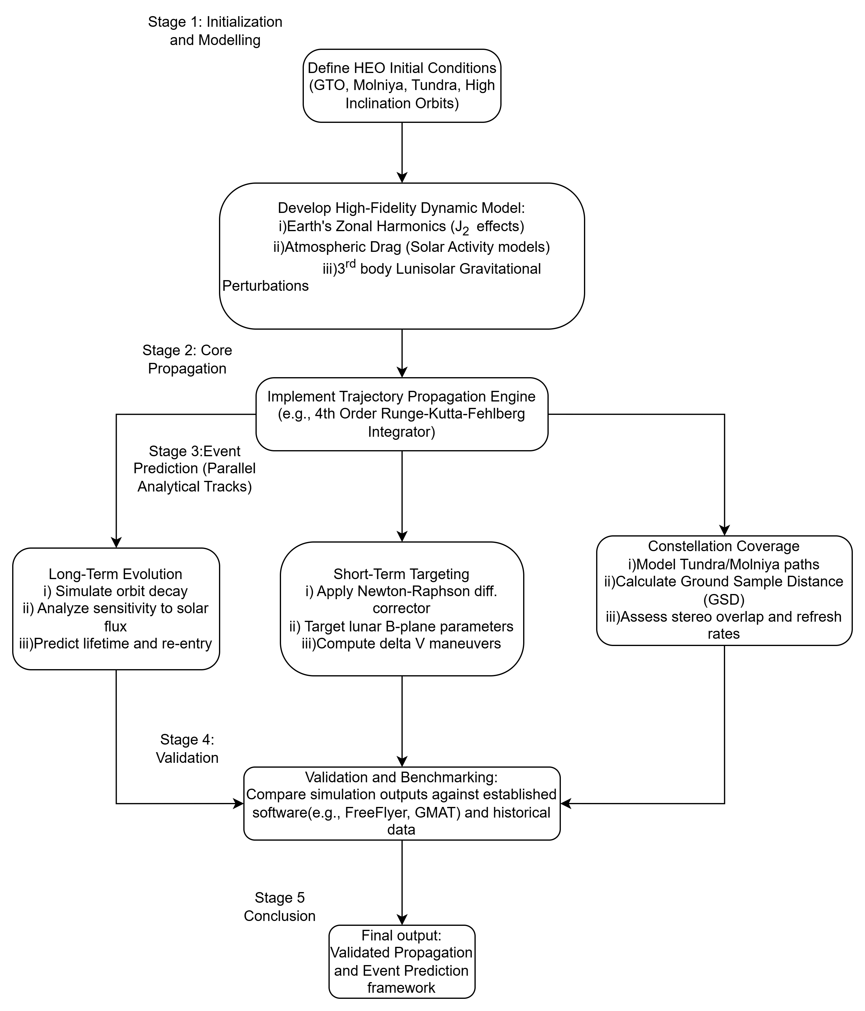
Methodology

Slide 25
Work Done
Comprehensive Literature Survey: Analyzed key research on Highly Eccentric Orbits (HEOs), including GTOs, Molniya, and Tundra orbits, to identify current prediction limitations.
Problem Identification: Formulated a targeted problem statement addressing the challenges of coupled dynamic environments
Project Scoping: Defined the primary and specific sub-objectives required to solve the identified problem.
Methodology Architecture: Designed the step-by-step workflow and propagation framework required for the simulation phases.
Parameter Definition: Identified the core variables (e.g., J₂ zonal harmonics, solar activity, 3rd-body gravity) needed for the high-fidelity dynamic model.
Simulation of object in GTO in unperturbed condition without the consideration of any higher order perturbations in order to understand the trajectory propagation of the object at the most basic level.

Slide 26
Work to be done
Stage 1: Implementing the numerical integrator
Implement and debug the trajectory propagation engine (e.g., Runge-Kutta 45 numerical integrator) on perturbed orbitals.
Stage 3: Simulation Execution
i)Track A:Run long-term simulations to analyze sensitivity and predict orbital lifetime/re-entry.
ii)Track B: Execute short-term targeting algorithms (Newton-Raphson) for Lunar Gravity Assists.
iii)Track C:Simulate HEO constellations to calculate real-time Earth coverage.
Stage 4: Validation & Benchmarking
Compare the framework's output against industry-standard astrodynamics software (e.g., FreeFlyer, GMAT) to verify accuracy.
Stage 5: Compiling an application
Developing an industry ready application with interactive UI to take in parameters like apogee, perigee positions, and inclination angle to simulate orbital propagation and transfer maneuvers between any two specified orbits considering fourth order perturbations.

Slide 27
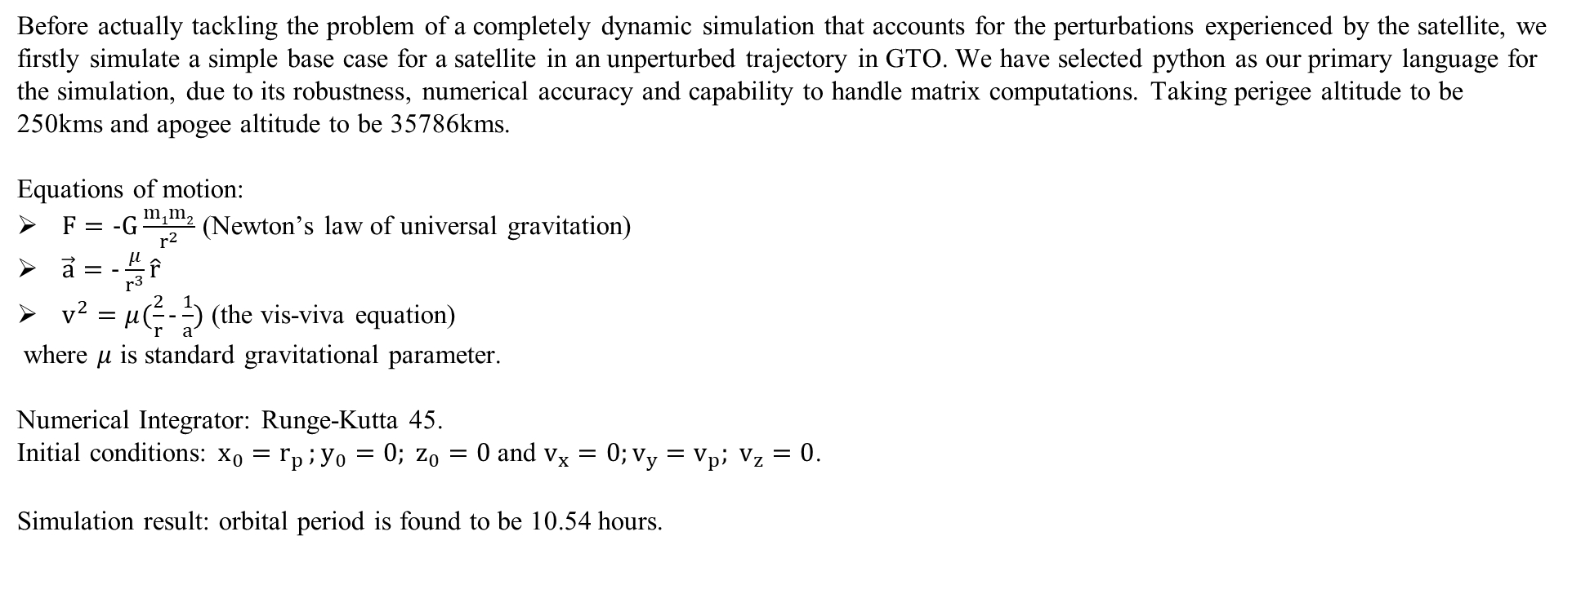
Simulation

Slide 28
Gantt Chart
 | February | March | April | May | June
Literature Review
Perturbation Model development
Simulation
Data validation
Event forecasting and optimization
Report

Slide 29
THANK YOU
ACS College of Engineering ■■■

